Slide 1
APIs (Application Programming Interface)
Structure of APIs, status codes, web services, demo

Slide 2



Introduction
In this chapter we will look at a very essential concept in programming, APIs.
Lots of companies have spent lots of resources and time creating wonderful solutions (payment, weather, music recognition). If we want to embed these solutions into our own applications, we have to use the APIs they created.

Slide 3
Introduction
By the end of this course, you’ll be able to:
Know some types of web services that exist
Describe how REST APIs are structured
Know the use of the different HTTP methods
Know the significance of the different status code classes.
Have some knowledge of how to interact with APIs using Postman

Slide 4
01
APIS

Slide 5
API
APIs serve as the intermediary layer that allows different software systems to communicate and interact with each other.
They define methods and protocols though which various components of software applications can interact.
APIs can be public (accessible by anyone) or private/restricted.
Payment APIs like CamPay permit developers to integrate payment (MoMo and OM) functionality into their applications without having to rebuild these payment systems.
Some other popular APIs include: social media APIs (Facebook, WhatsApp, TikTok) that permit to automate user actions on these sites or weather APIs.

Slide 6
Web services
Web services are specific types of APIs made to function via the web
Types of web services:
SOAP (Simple Object Access Protocol): a protocol based on XML, imposing a strict set of rules for communication
REST (Representational State Transfer): more flexible and are based on simpler data formats (JSON) and communication protocol (HTTP)
GraphQL: An amelioration of REST, permits the querying of endpoints. Uses similar protocols and data formats.

Slide 7
HTTP (Hypertext Transfer Protocol)
HTTP is a protocol used for transmitting hypermedia documents, such as HTML. - It enables communication between clients (e.g., web browsers) and servers over the internet.
HTTP clients use different HTTP methods to request for resources from the server
GET: used to retrieve data from the server
POST: submit data to be processed by the server, used for resource creation
PUT: Update/add a resource to the server
DELETE: remove data from the server
PATCH: apply partial modifications to a resource.

Slide 8
HTTP (Hypertext Transfer Protocol)
When the servers have treated the client requests, they add status codes to the response. The status codes have the following significance:
20X: Success
30X: Redirection
40X: Client Error
50X: Server Error
Some common HTTP status codes
Status Code | Name | Description
200 | OK | Request processed successfully.
201 | Created | Request successful, resource created
204 | No Content | Request processed successfully, no content was returned
301 | Moved Permanently | The resource has been moved to another location

Slide 9
Some common HTTP status codes
Status Code | Name | Description
302 | Temporary Redirect | Temporary redirection to another URL for maintenance purposes usually
400 | Bad Request | Client erro such as invalid parameters or invalid data.
401 | Unauthorized | The request requires authentication
403 | Forbidden | The client does not have permission to access the requested resource
404 | Not Found | Server cannot find the requested resource
405 | Method Not Allowed | The HTTP method used in the request is not supported for the specified resource.
500 | Internal Server Error | Server encountered an unexpected condition, preventing it from fulfilling the request.
503 | Service Unavailable | Server is unable to handle the request

Slide 10
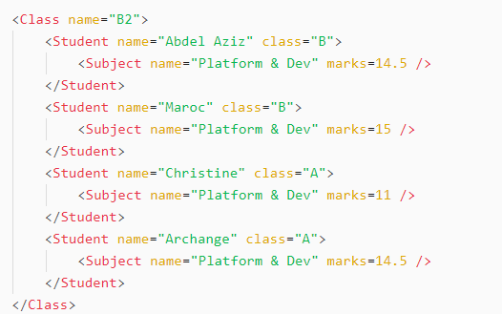
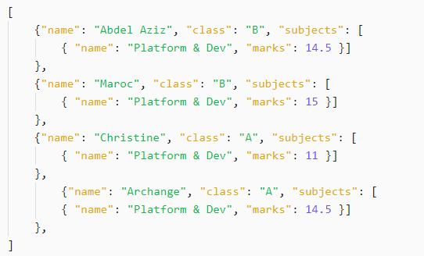
Data Formats - XML, JSON
XML
JSON
XML is a structured, hierarchical data format used for exchanging information between applications.
Commonly used in SOAP-based APIs.
JSON is a lightweight data format used in RESTful APIs.
It is more human-readable and efficient compared to XML.

Slide 11
REST API Creation Guidelines
REST is an architectural style for modeling distributed systems as a set of resources.
Resources can be data, objects, or services that can be accessed by clients.
Every resource is represented by a URI which uniquely identifies the resource.
Also, REST APIs (based on HTTP) are built around the HTTP actions such as GET, POST, PUT, DELETE, and PATCH.
Organizing the APIs around resources
Entities are often grouped into collections (for example, users, items, orders, etc). Use plural nouns to represent collections.
Sending an HTTP GET request to a collection resource (example: /orders) returns a list of items in the collection. Whereas the URL “/orders/12345” represents a path to order with id 12345.

Slide 12
REST API Creation Guidelines
Define operations in terms of HTTP methods
Use the appropriate methods for the different actions to be performed on the endpoint
Avoiding chattiness: avoid making the user have to send multiple requests back and forth. To do this, you can implement endpoints that can add multiple resources at once, as well as those for bulk delete and bulk updates.
Pass the correct error codes and descriptions to the clients.
API documentation is a reference manual containing all the information to work with the API (e.g.authentication/authorization, input/output payloads, headers and parameters).
Some API description formats include Swagger Open API specification and RAML. Look into Stripe API specification to get a good example

Slide 13
GraphQL
GraphQL is an API query language that defines specifications of how a client application should request data from a remote server.
You can use GraphQL in your API calls without relying on the server-side application to define the request.
GraphQL vs REST
They both allow you to create, update and delete data via API. APIs developed with REST are known as RESTful APIs while those with GraphQL are GraphQL APIs.
Both are stateless, so the server does not save response history between requests
Both HTTP-based and use a client-server model.

Slide 14
GraphQL
GraphQL vs REST
REST and GraphQL both design their data interchange around resources. Each resource has its own unique identifier (URI) and a set of operations (HTTP methods) that the client can perform on it.
Both REST and GraphQL support similar data formats. JSON is the most popular format but XML and HTML are sometimes used.
They both work with any database and programming language, highly interoperable with any application.

Slide 15
GraphQL
GraphQL vs REST (differences)
Overfetching and underfetching: REST APIs always return a whole dataset. GraphQL emerged as a query-based solution, queries can extract the exact data in only one API request and response.
Error handling: GraphQL is a strongly typed API architecture, due to the level of detail in the schema, the system can automatically identify request errors and provide useful error messages. REST APIs are weakly typed, and you must build error handling into the surrounding code.

Slide 16
GraphQL
When to use GraphQL or REST
They can be used interchangeably but some use cases are a better fit for one or the other
When to use GraphQL
You have limited bandwidth, and you want to minimize the number of requests and responses
You have multiple data sources, and you want to combine them at one endpoint
You have client requests that vary significantly, and you expect very different responses

Slide 17
GraphQL
When to use GraphQL or REST
When to use REST
You have smaller applications with less complex data
You have data and operations that all clients use similarly
You have no requirements for complex data querying
This article from Amazon Web Services goes into more detail into this.

Slide 18

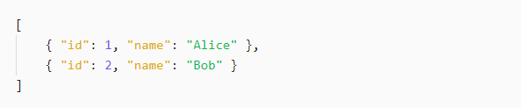
Example of an API
A simple REST API for user management:
Endpoint: https://api.example.com/users
GET Request (retrieve all users)
Response

Slide 19
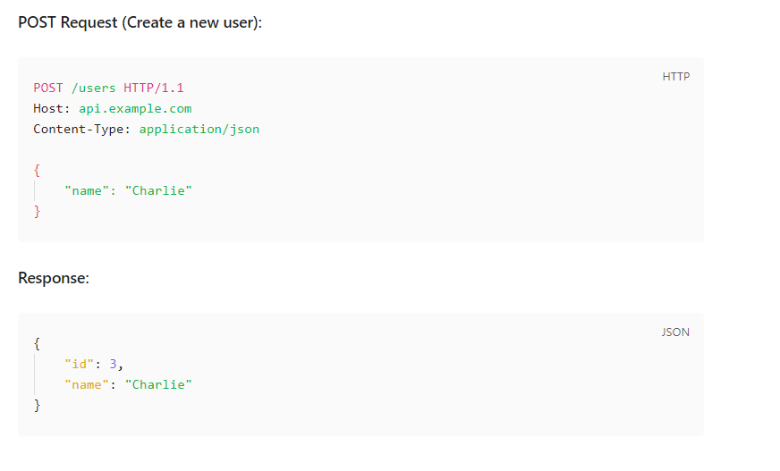
Example of an API

Slide 20
PRACTICAL: Interacting with a Payment API

Slide 21


